Slide 1
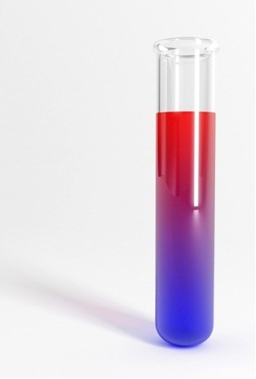
The effect of concentration on the rate of a reaction
Practical Work for Learning

Slide 2
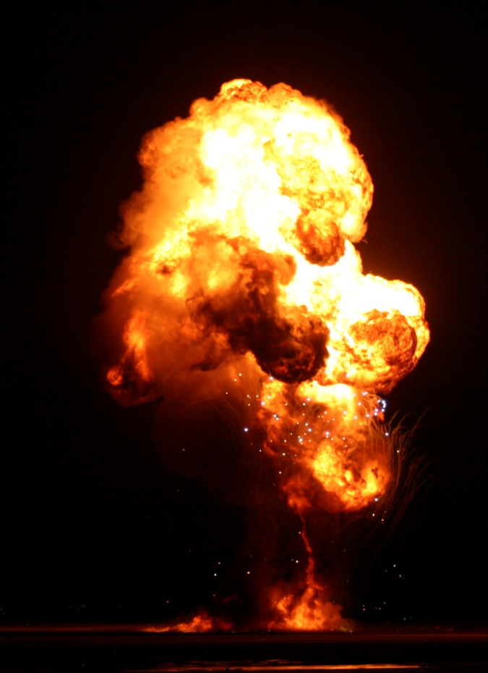
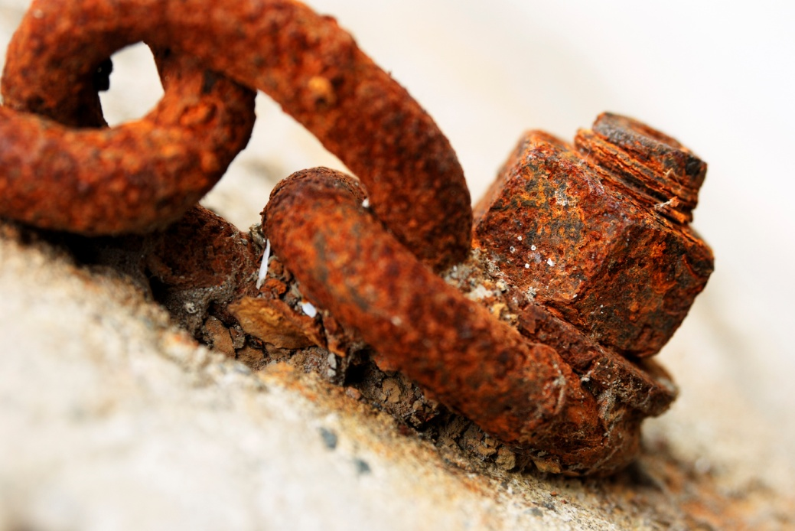
Chemical reactions can be ...
fast…
…or slow.

Slide 3
Learning outcomes
You will be able to ...
evaluate different models for explaining the rates of reactions
use experimental data to identify how the concentration of each reactant affects the rate of a reaction

Slide 4
What you already know
Organise what you know about the reaction of marble chips with hydrochloric acid into three categories.
Practical techniques equipment and methods
Observations / data / summaries of data including from previous experimental work, e.g. graphs, or statements summarising a trend/pattern
Explanations inferences, models, type of reaction, equations

Slide 5
What is rate of reaction?
In a chemical reaction, reactants are used up and products form.
A + B → products
In this reaction A and B are the reactants. They are used up.
Rate of reaction is the rate at which reactants are converted to products.

Slide 6
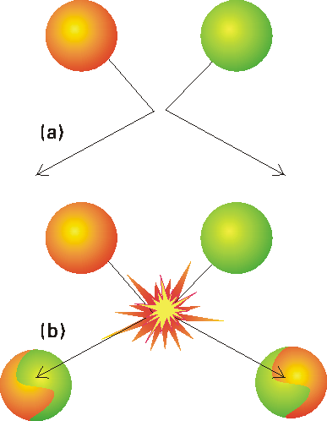
Models of rate
Collision theory can make qualitative predictions.
It can predict how the rate may change with
changing conditions – but not by how much.
A mathematical model can make quantitative predictions.
A rate equation is a mathematical model.
(This is different from the chemical equation for the reaction).
What is the relationship between rate and the concentration of acid in the reaction with marble chips?

Slide 7
A mathematical model
The rate could be proportional to the concentration of acid:
r_{HCl} ∝[HCl]
or
r_{HCl} = k[HCl]
r_{HCl} = rate of change of concentration of HCl
(mol dm^{–3} s ^{–1})
k = a constant (the rate constant)
[HCl] = concentration of HCl (mol dm⁻³)
If this was the mathematical relationship between rate and concentration, what would the graph look like?

Slide 8
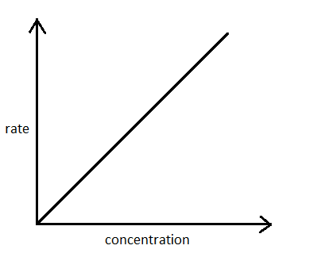
A mathematical model
r_{HCl} = k[HCl]
If the rate is proportional to the concentration of acid…
…the graph will look like this.
Double the concentration, and the rate doubles.

Slide 9
A mathematical model
The rate could be proportional to the square of the concentration of acid:
r_{HCl} ∝[HCl]²
or
r_{HCl} = k[HCl]²
If this was the mathematical relationship between rate and concentration, what would the graph look like?

Slide 10
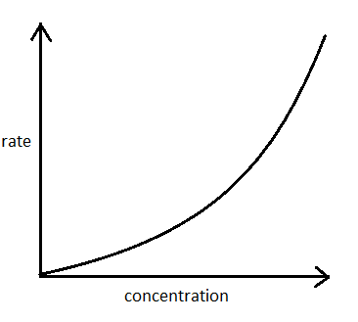
A mathematical model
r_{HCl} = k[HCl]²
If the rate is proportional to the square of the concentration of acid…
…the graph will look like this.
Double the concentration, and the rate goes up 4 times (2²).

Slide 11
A mathematical model
Maybe the rate is constant and is not affected the concentration of acid at all:
r_{HCl} = k
or
r_{HCl} = k[HCl]⁰
If this was the mathematical relationship between rate and concentration, what would the graph look like?

Slide 12
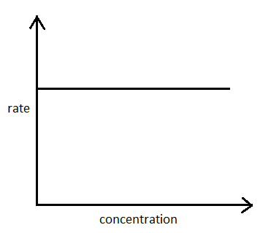
A mathematical model
r_{HCl} = k
If the rate is not affected by the concentration of acid…
…the graph will look like this.
Double the concentration, and the rate stays exactly the same.

Slide 13
Rate and concentration
So there are three possible models:
r_{HCl} = k This is called zero order ([HCl]⁰)
r_{HCl} = k[HCl] This is called first order ([HCl]¹)
r_{HCl} = k[HCl]² This is called second order ([HCl]²)
To find the order of reaction for marble and acid we need to collect some data …

Slide 14
Rate and concentration
So, how can you measure rate?
Rate cannot be measured directly. So what can we measure?
Time
Concentration
Volume of gas
Change in mass

Slide 15
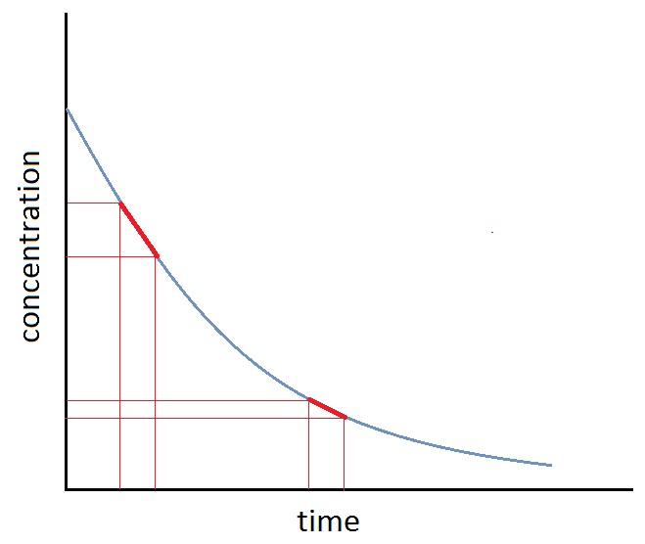
Rate and concentration
Rate of change of concentration cannot be measured directly.
It can be found by analysing measurements of concentration over time.
How fast is the concentration falling at any one time? The gradient of the concentration–time graph tells us about the rate.
A steep gradient means a fast rate.
A shallow gradient means a slow rate.

Slide 16
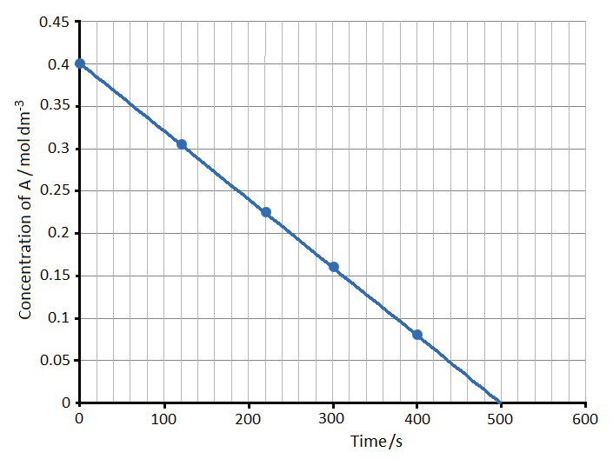
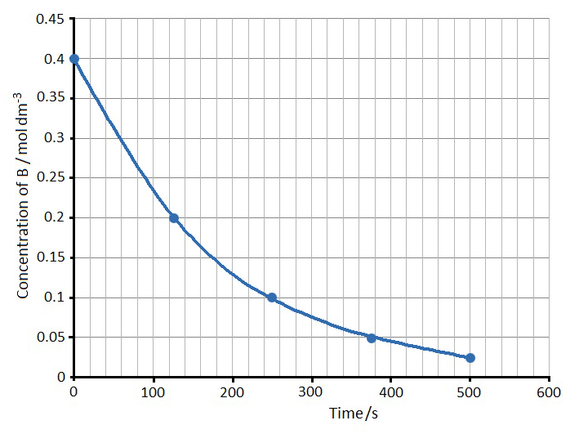
Here are the concentration–time graphs for two different reactions.
For each graph decide whether the rate is:
zero order: r_{A} = k
first order: r_{A} = k[A]
second order: r_{A} = k[A]²
Explain your decision.
Graph 1
Graph 2

Slide 17
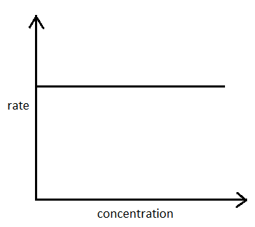
Graph 1
At any concentration the gradient of the graph is the same.
So the rate of reaction is always the same.
The rate is not affected by the concentration.
The rate equation is
r_{A} = k

Slide 18
Graph 2
As the concentration decreases the gradient and therefore the rate of reaction also decreases.
The rate is affected by the concentration.
The rate equation could be
r_{A} = k[A] or r_{A} = k[A]²

Slide 19
Problem
For this reaction, what is the rate equation?
CaCO₃(s) + 2HCl(aq) → CaCl₂(aq) + CO₂(g) + H₂O(l)
You cannot measure the concentration of hydrochloric acid directly. What could you measure instead?
We can measure something directly proportional to concentration:
volume of gas collected, or change in mass.
To do
a Carry out the experiment. b Draw graphs of the results to find out the rate equation.

Slide 20
The reaction of marble chips with hydrochloric acid is first order with respect to hydrochloric acid.
r_{HCl} = k[HCl]
Orders of reaction are experimental quantities. They cannot be deduced from the chemical equation for the reaction.

Slide 21
Rate equations
For a reaction in solution: A(aq) + B(aq) → products
You could find the rate of change of concentration of A (r_{A})
by measuring the concentration of A, during the reaction.
You could find the rate of change of concentration of B (r_{B})
by measuring the concentration of B, during the reaction.
r_{A} and r_{B} might have different values.
It is important to state which substance the rate refers to when talking about rates of reaction.

Slide 22
Rate equations
A rate equation can be used to describe the rate of change of concentration of substance A:
r_{A} = k[A]^{m}[B]^{n}
The indices m and n tell you the ‘order of reaction’
m is the ‘order of reaction with respect to reactant A’
n is the ‘order of reaction with respect to reactant B’
m+n = the overall order of the reaction
At this level you will only meet reactions which are zero, first or second order, although other orders are possible.

Slide 23
Order of reaction: zero order
In a zero order reaction, m = 0
The rate equation is: r_{A} = k[A]⁰ or r_{A} = k
What would the data look like
if you plotted [A] against time for this reaction?

Slide 24
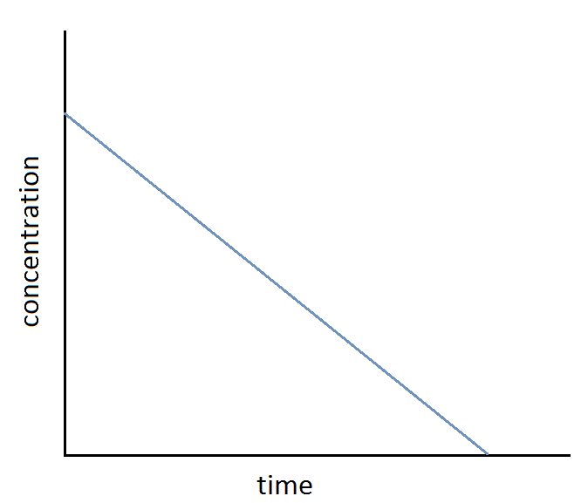
Order of reaction: zero order
The rate of change of [A] is shown by the gradient of the graph.
r_{A} = k
The rate is constant.
For any concentration of A, the gradient of the graph (rate) is the same. The graph is a straight line.
The rate does not change if the concentration changes.

Slide 25
Order of reaction: first order
In a first order reaction, m = 1
The rate equation is: r_{A} = k[A]¹ or r_{A} = k[A]
What would the data look like if you plotted [A] against time for this reaction?

Slide 26
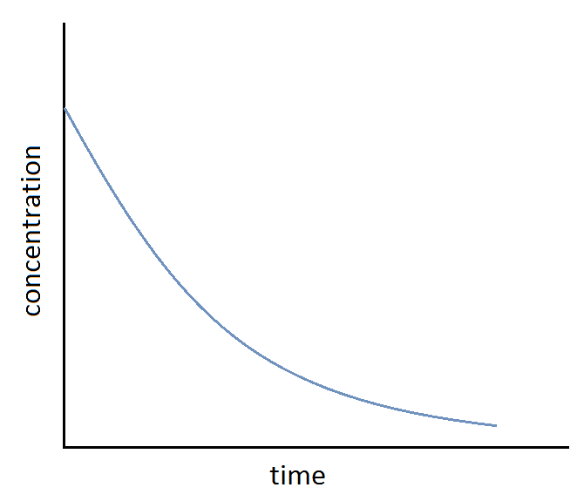
Order of reaction: first order
The rate of change of [A] is shown by the gradient of the graph.
r_{A} = k[A]
The rate is proportional to [A].
As [A] decreases the rate of reaction decreases, and the gradient of the graph decreases.
The graph is a curve. The time it takes for [A] to be halved (the half-life) is constant, whatever the value of the concentration you start with.

Slide 27
Order of reaction: second order
In a second order reaction, m = 2
The rate equation is: r_{A} = k[A]²
What would the data look like if you plotted [A] against time for this reaction?

Slide 28
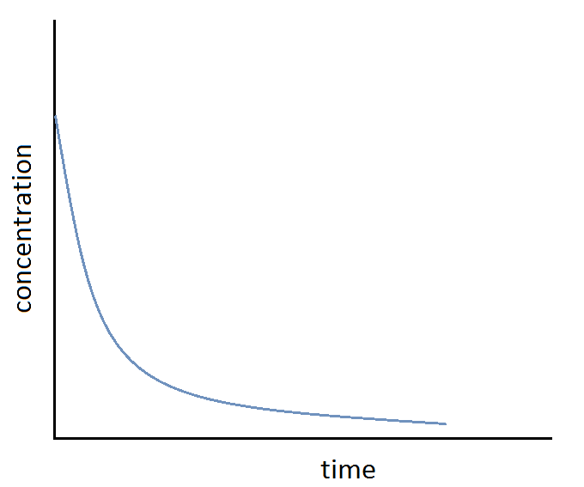
Order of reaction: second order
The rate of change of [A] is shown by the gradient of the graph.
r_{A} = k[A]²
The rate is proportional to [A]².
As [A] decreases, the rate of reaction decreases rapidly, and the gradient of the graph decreases rapidly.
The curve of the graph is deeper than for a first order reaction.
The half-life increases dramatically as the reaction proceeds.

